Slide 1
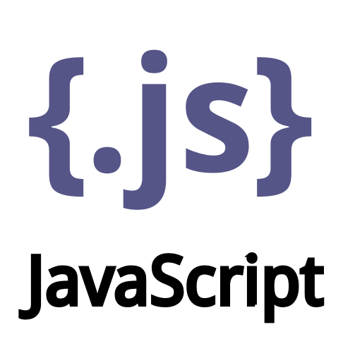
JavaScript
JavaScript history
JavaScript runtime environments
DOM – Document Object Model
HTML, CSS and JavaScript – The Big Trio!
jQuery and AJAX
Static Website vs Dynamic Website (MPA)
Single Page Application (SPA)
Most used JavaScript web frameworks
React Native – overview
NodeJS – overview
Software what I am using for JavaScript development (editors, runtime, etc.)
Backend vs Frontend vs Full-Stack developer
Bonus: JavaScript in Machine Learning
Bonus: JavaScript in Robotics

Slide 2
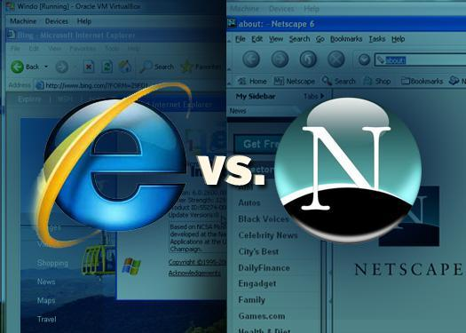
JavaScript history (part 1)
JavaScript is a programming language created by Netscape programmer Brendan Eich in 1995.
JavaScript is tightly coupled to the Browser Wars in 1996 – 1997 between Netscape Navigator and Microsoft Internet Explorer.
In 1997 Netscape submitted JavaScript to the ECMA International standards organization to ensure its standardization. The result is ECMAScript which is the official specification of the language.
ECMA is a industry association dedicated to the standardization of information and communication systems.

Slide 3

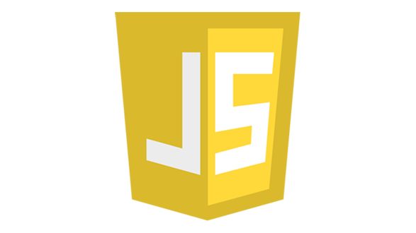
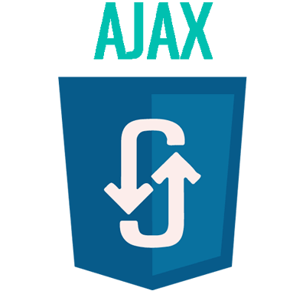
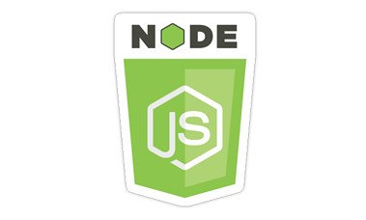
JavaScript history (part 2)
In early 2000s appears AJAX – (Asynchronous JavaScript and XML). It is set of techniques that allow webpage to retrieve/send data asynchronously from/to the server without page reload.
2006 – 2010 appears jQuery. It is very fast and lightweight JavaScript library that helps in DOM manipulation, event handling, AJAX calls, etc.
In 2009, the American software engineer Ryan Dahl released Node.js, allowing JavaScript to be used for server-side programming. Node.js integrates V8 engine which is JavaScript open-source engine developed by Google and written in C++.
2010 – nowadays appear many new JavaScript frameworks and libraries as: ReactJS, Angular, Vue.js, React Native, etc.

Slide 4
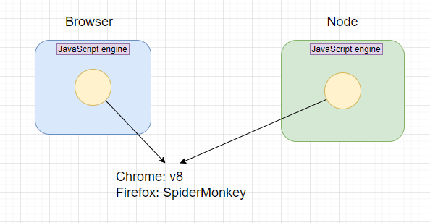
JavaScript runtime environments

Slide 5

What is DOM (Document Object Model)
The Document Object Model is tree of nodes/elements created by the browser.
DOM elements have an object representation.
When a web page is loaded, the browser creates a Document Object Model of the page.
JavaScript can be used to read/write/manipulate the DOM

Slide 6
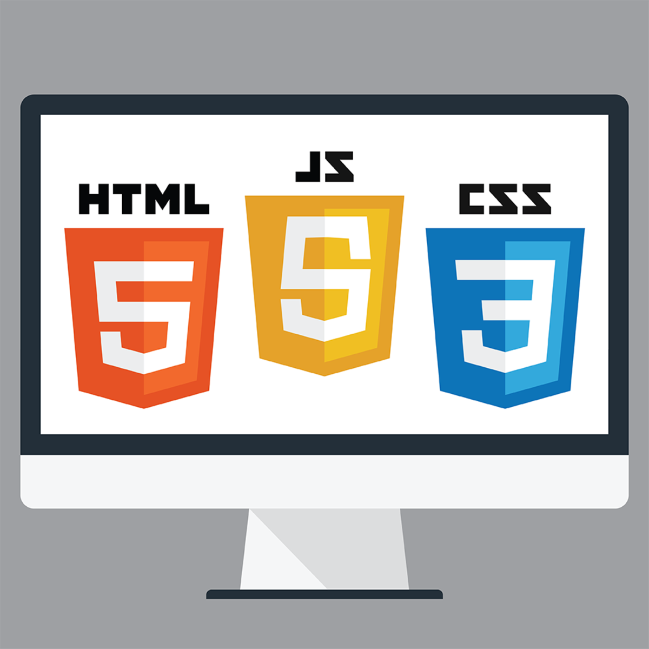
HTML, CSS and JavaScript
HTML – structure of web page
CSS – visual style of web page
JavaScript – interactivity of web page

Slide 7
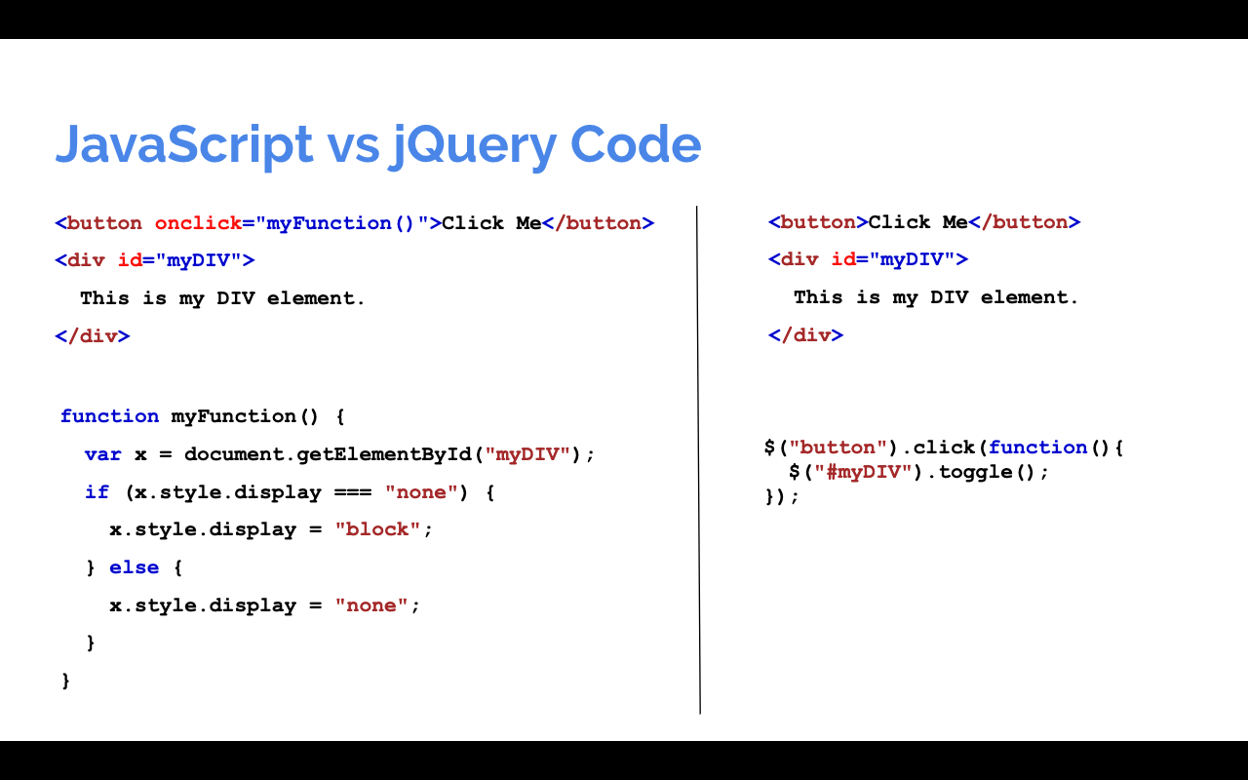
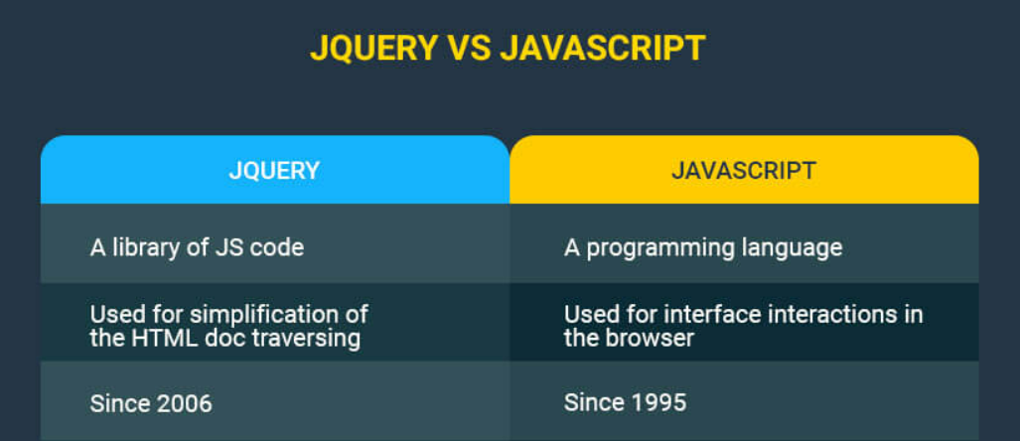
jQuery
jQuery is a fast, small, and feature-rich JavaScript library. It makes things like HTML document traversal and manipulation, event handling, animation, and AJAX requests much simpler.
Code comparison

Slide 8
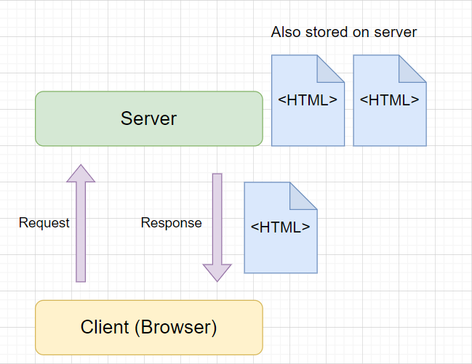
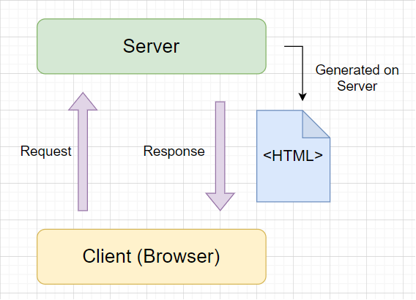
Static website vs Dynamic website (MPA)
Static Website
Dynamic Website

Slide 9
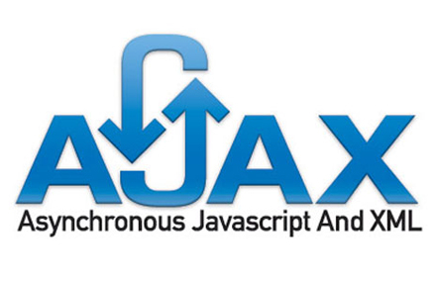
AJAX
AJAX is a developer's dream, because you can:
Terminology: It is a combination of programming techniques for requesting and receiving of data from server in async way.
Update a web page without reloading the page
Request data from a server - after the page has loaded
Send data to a server - in the background

Slide 10
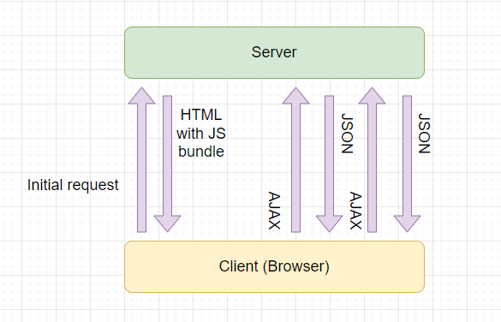
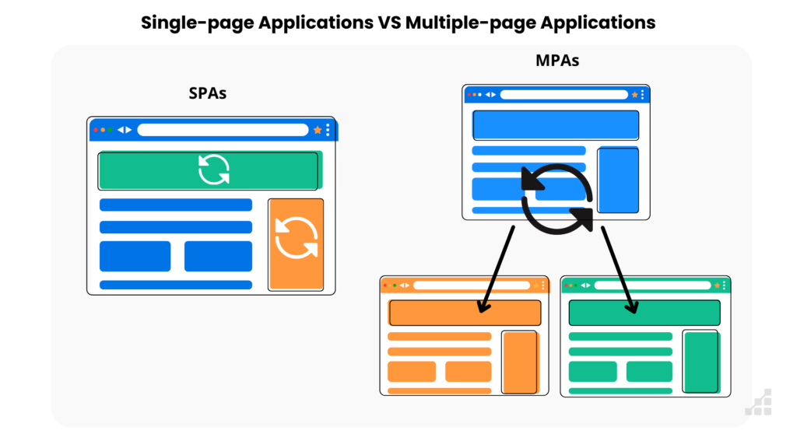

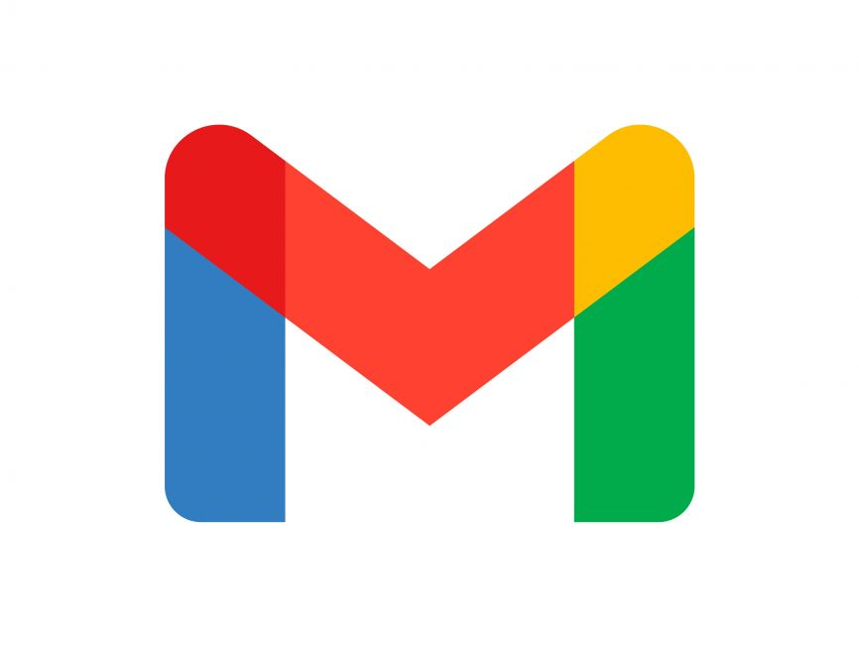
Single Page Application (SPA)
A single-page application is a web application that loads only a single page. It then rewrites the page with new content fetched from a web server as the user interacts with it instead of loading a new page for every interaction.
Single Page App

Slide 11
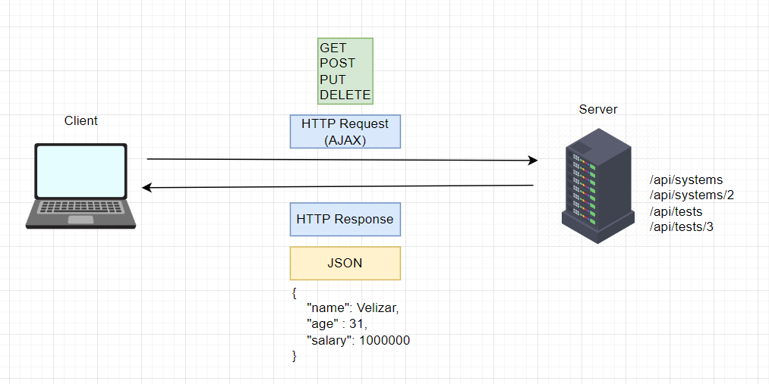
Powered by Web APIs
Web APIs are software that are collections of operations on server resources which we can do via HTTP protocol.
Web APIs can be written in many backend programming languages like C# (ASP .NET Core), JavaScript (NodeJS), Python (Django), etc.
All big/large companies have their own APIs that can be consumed by everyone.

Slide 12

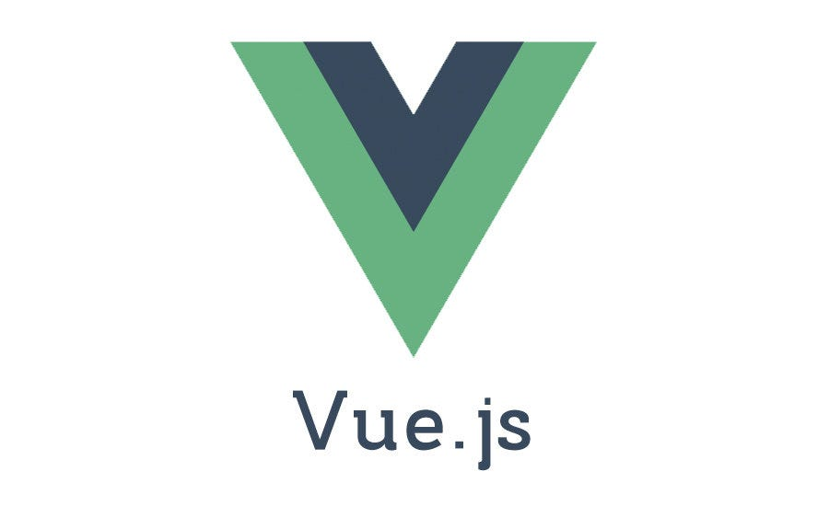

The most used JS Web frameworks today
Framework maintained by Google
Library created by Facebook
Framework maintained by core team members
Open-source
Open-source
Open-source

Slide 13

React Native
React Native is a JavaScript open-source framework used for mobile application development (Android and iOS) created in 2015 from Meta.
Normally for iOS development are needed Objective-C or Swift and for Android development are needed Java or Kotlin as a programming languages.
React Native uses ReactJS library internally.

Slide 14
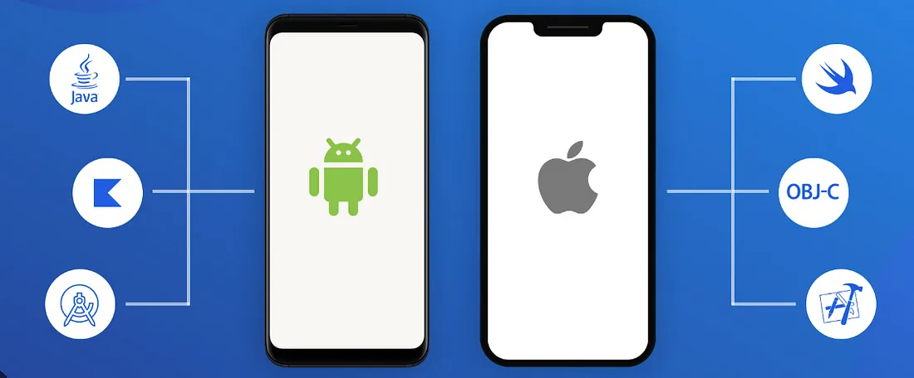





React Native as a massive choice
Many mobile applications today are powered by React Native instead of the specified languages and frameworks for Android and iOS.
Examples: Facebook, Instagram, Walmart, Discord, Skype, Tesla and many more.

Slide 15
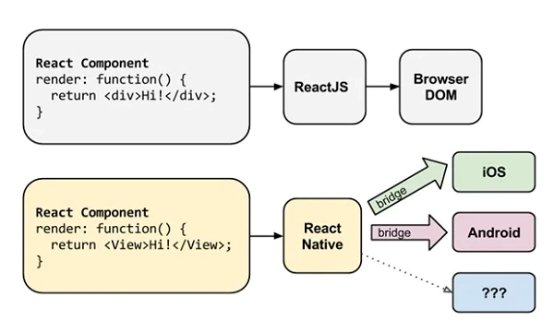
React components

Slide 16
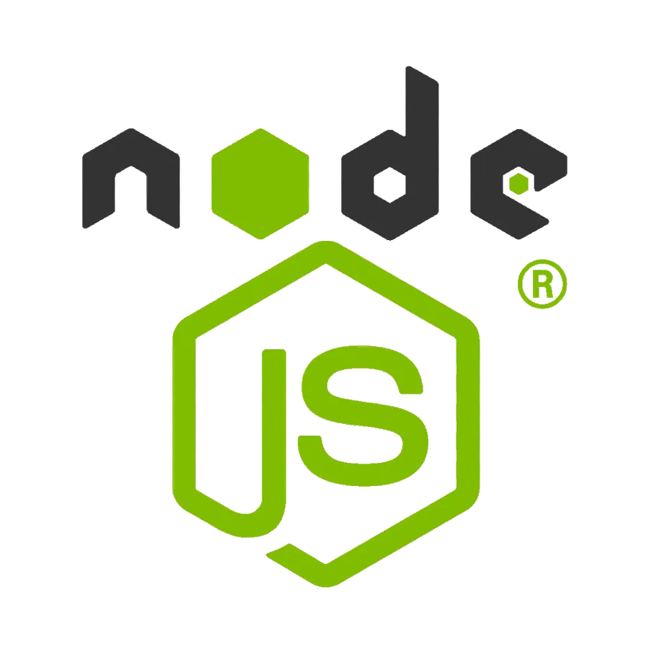
NodeJS
Node.js is a free, open-source, cross-platform JavaScript runtime environment that lets developers create servers, web apps, command line tools and scripts.
NodeJS is a JavaScript runtime built on Chrome's V8 JavaScript engine.
It is written by Ryan Dahl in C++ programming language.

Slide 17
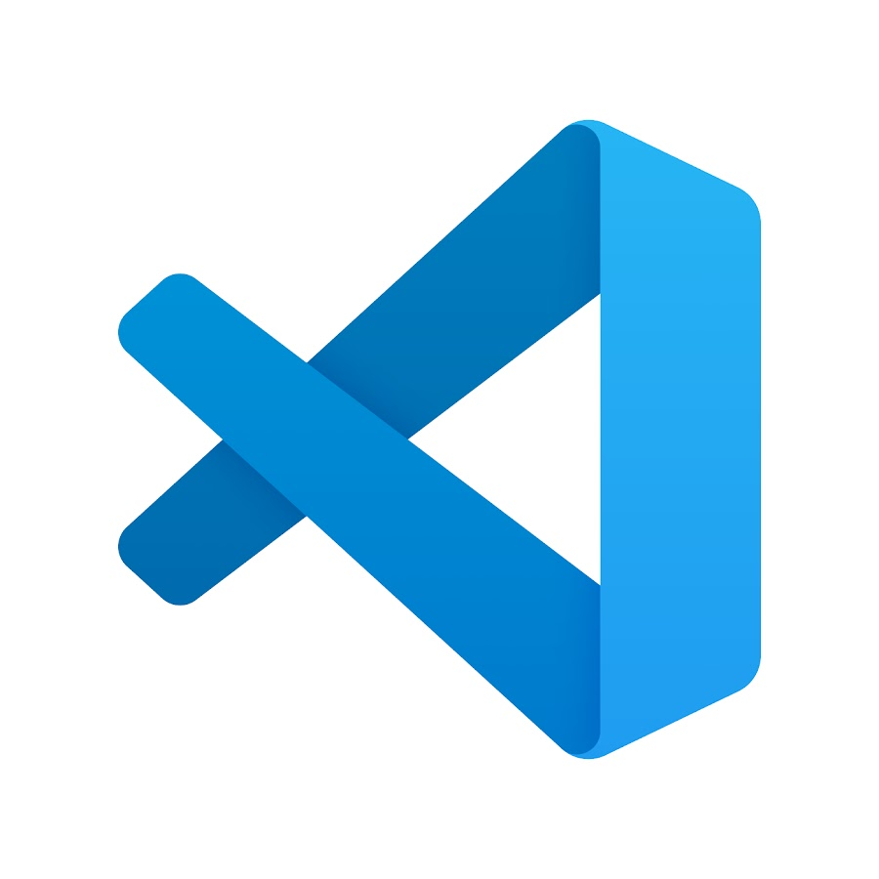
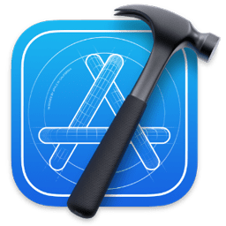


What kind of software I am using for React Native development?
Text Editor: VS Code
Runtime: NodeJS
Package manager: npm
Mobile Framework: React Native
Dev dependencies: Android Studio, Xcode

Slide 18
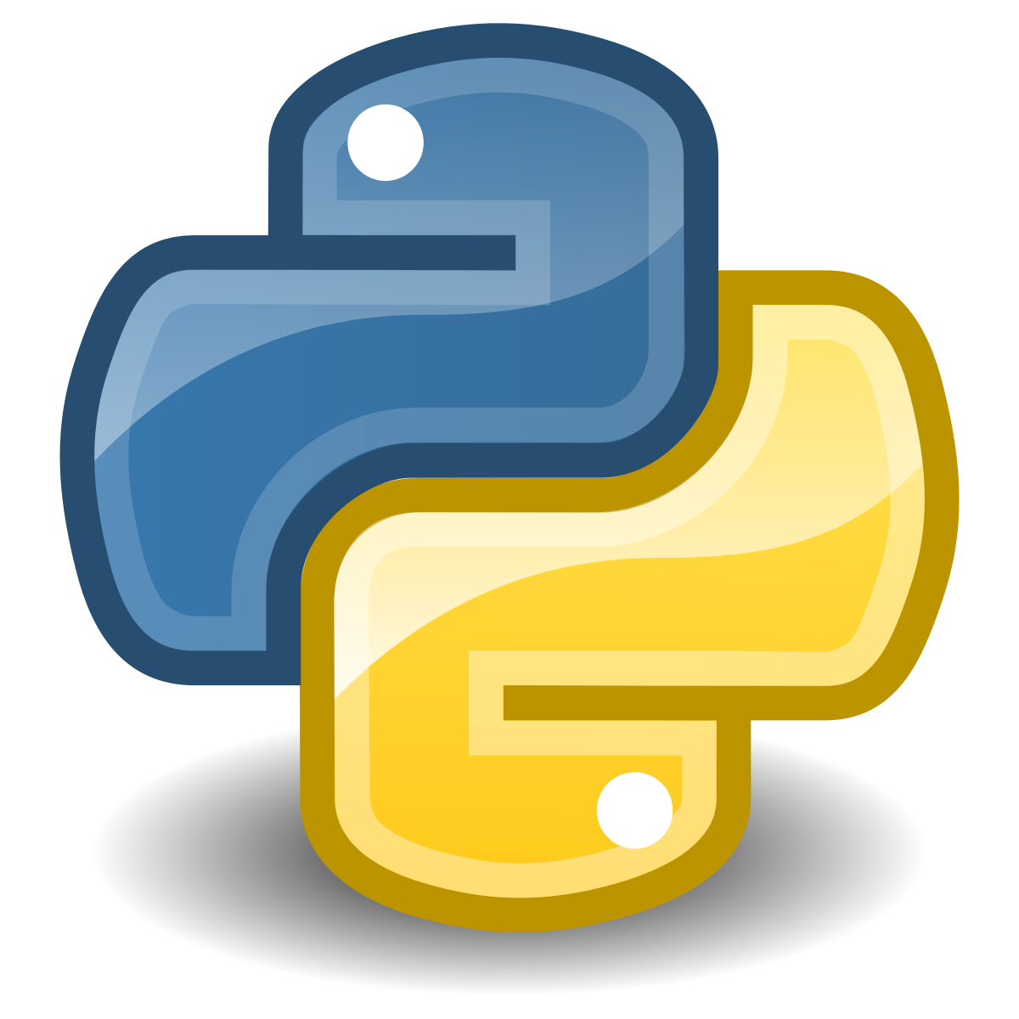
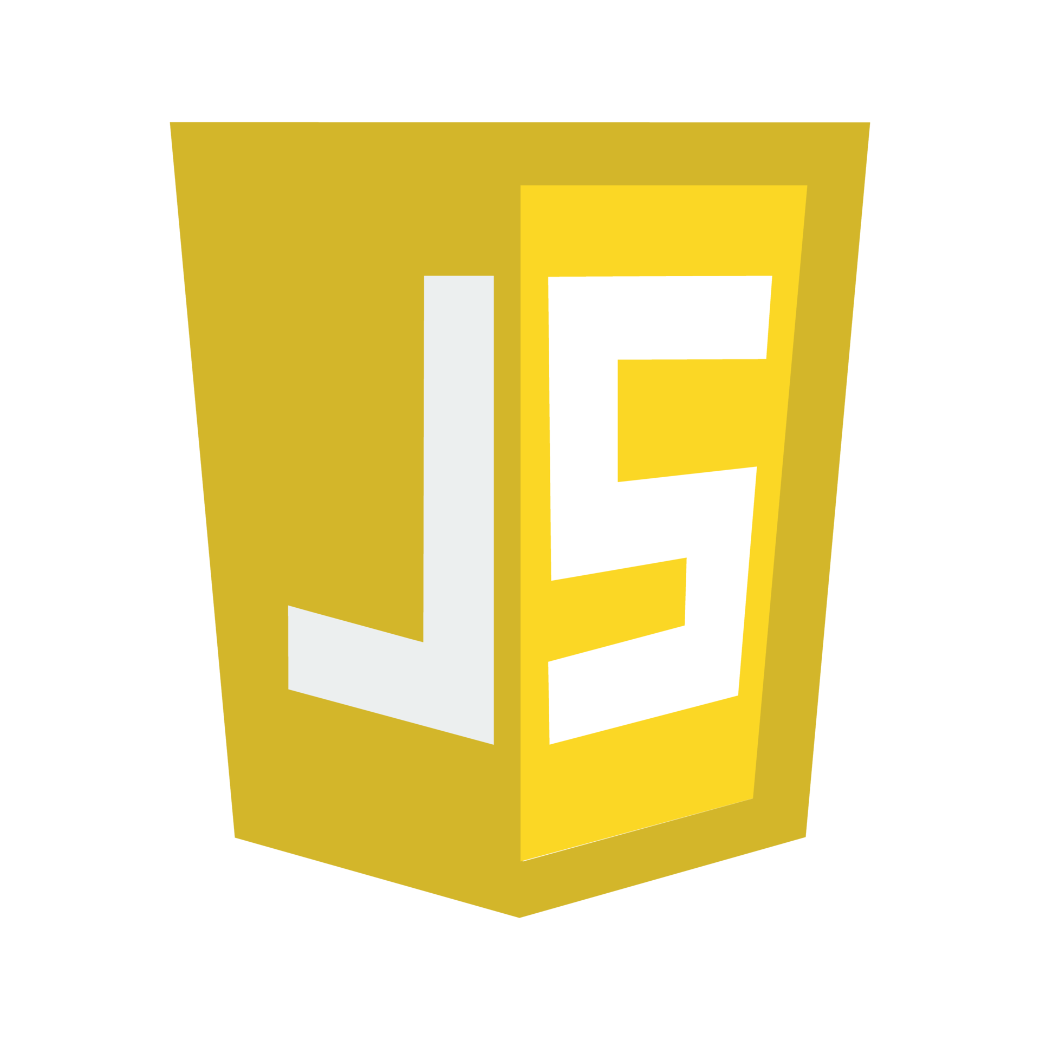
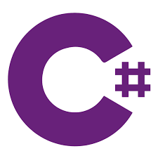
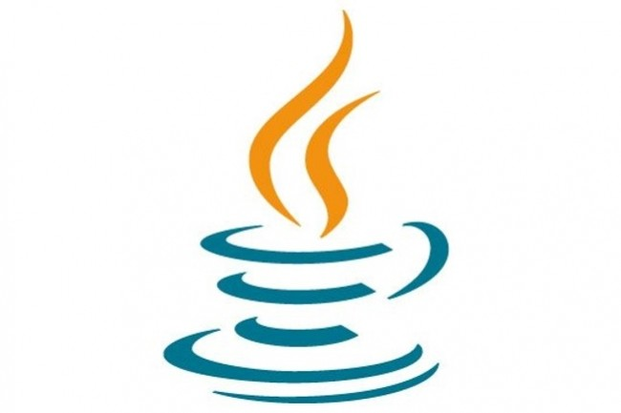
Backend vs Frontend vs Full-Stack developer
Frontend
Full-Stack
Backend
+

Slide 19

JavaScript in Machine Learning
TensorFlow.js
ML.js
Neuro.js
Brain.js
OpenCV.js
ML5.js
WebDNN
Synaptic

Slide 20



JavaScript in robotics
JavaScript is a versatile programming language that is widely used for web development, but it can also be used for other applications, including robotics.
In fact, there are several JavaScript libraries and frameworks available that are specifically designed for robot programming.

Slide 21

Thank you!
Author: Velizar Gerasimov
Position: Programmer Software Applications

